Slide 1
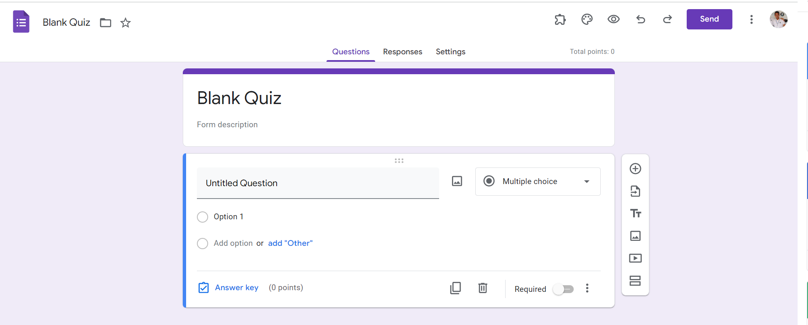
Identify root components of website below

Slide 2
Flex-direction: column
Navigation
Withd: 100vh
Flex 1
Withd: 60vh
Header
Flex 1.5
Main
Withd: 70vh
Flex 2.5

Slide 3
Navigation
div
div
Flex :1
Flex :1
div
Display: flex
Justify-content: space-between

Slide 4
Navigation
icon
title
icon
icon
text
icon
icon
icon
icon
button
icon
icon
title
title
title
Display: flex
Display: flex
Justify-content: space-between
Justify-content: space-between
Display: flex
Justify-content: space-between

